Slide 1

Security Principle 1: Authentication
Verifying identity in the digital world

Slide 2
What is Authentication?
Authentication: verifying the identity of a user, process, or device, to allow access to resources in a system
It basically proving who you say you are, technology equivalent of showing your ID when voting in elections.

Slide 3
Why does Authentication matter?
Authentication matters because it ensures that only authorised users can access the organisation’s information.
Authentication helps protect against unauthorised access and harm to sensitive data, such as modification or fraud.
  Password breaches are the root cause for 80% of breaches (National Cyber Security Centre, 2022).
  Data in 2019 showed that 23.2 million victim accounts worldwide used 12345 as a password (National Cyber Security Centre, 2019).
  Security attacks are continuing to evolve, and yet online users are not doing enough to protect data and systems.
Let's see what happens when authentication fails in Ubuntu and AWS, and how to fix it.

Slide 4
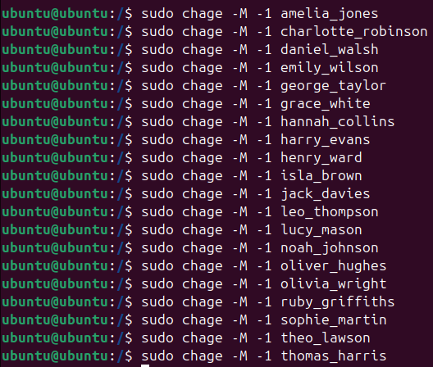
Initial Linux Vulnerable Setup
No password requirements have been set – allows employees to set their passwords without restriction
  User can set a password as easy as 123 or dictionary words
No password expiry date policy – employees’ passwords remain the same indefinitely
  “sudo chage -M -1 username”
  “sudo chage” – Linux command to change password expiry
  “-1” – password expiry removed
Figure 1: 20 employees of the organisation have no expiry date for their passwords

Slide 5
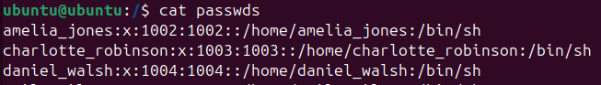
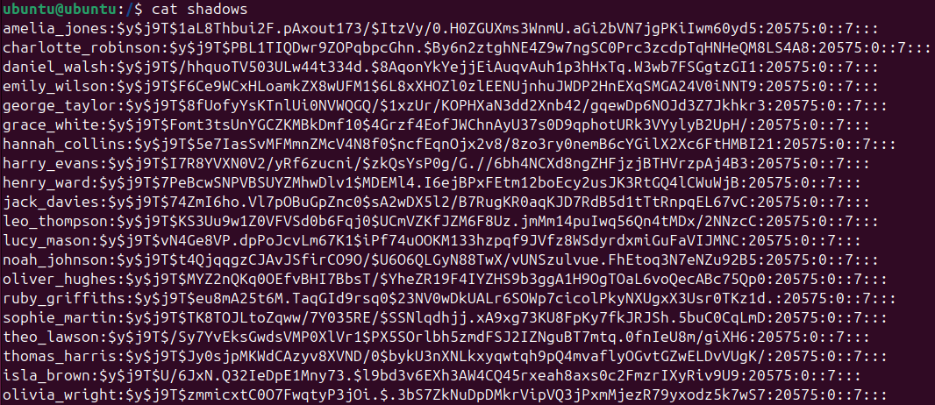
Linux Exploitation Process
The hacker uses two files within Linux to obtain passwords:
  passwds.txt – text file database that stores user information
  shadows.txt – text file database that stores hashed passwords (The Anshuman, 2023)
These two files are used because the username of an employee’s account is user information, while password hashes help obtain passwords.
Password hashes – store passwords without revealing their contents. It is used to compare to a password being verified
Figure 2: Part of the contents of the passwds.txt file being shown using the cat command.
Figure 3: Part of the contents of the shadows.txt file being shown using the cat command.
Notes:
The_Anshuman (2023). Understanding /etc/passwd and /etc/shadow Files - The_Anshuman - Medium. [online] Medium. Available at: https://medium.com/@The_Anshuman/understanding-etc-passwd-and-etc-shadow-files-58630eb0eda8.

Slide 6
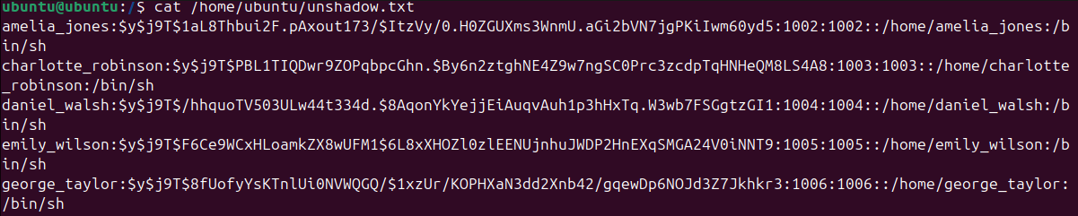
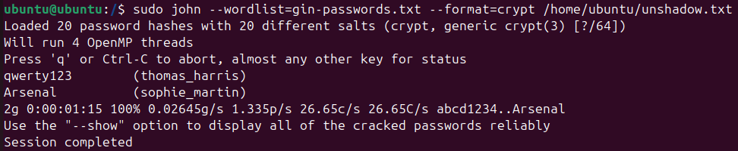
Linux Exploitation Process
To combine the employee’s data from both files, the hacker uses the unshadow command and creates a new file named unshadow.txt.
The hacker creates a second file named gin-passwords.txt. This file contains a list of common passwords used online.
“John the Ripper” software is used to compare the list of passwords in gin-passwords.txt against the employees’ data in unshadow.txt.
If any passwords in gin-passwords.txt match the password hashes, then “John the Ripper” will display the password alongside the user
Figure 4: Part of the contents of the newly created unshadow.txt file being shown using the cat command.
Figure 5: Successful dictionary-based attack using “John The Ripper”

Slide 7
Why did the exploitation work?
The exploitation worked because the passwords of the two users were either dictionary-based words or commonly used passwords.
  Thomas Harris – qwerty123 – common password because all characters are close to each in the keyboard
  Sophie Martin – Arsenal – dictionary word mostly affiliated with the football club bearing the name
Passwords with dictionary words or common combinations have low-time complexity. Because of this, “John the Ripper” had common combinations to try (characters close to each other on a keyboard) and was able to rely on simple words from the dictionary to obtain the passwords.
These easy passwords were implemented because there were no password policies put in place – a failure on the part of the organisation’s weak security procedures.
Compromised accounts can lead to unauthorised access of the organisation’s sources, allowing attackers to obtain or modify sensitive data.

Slide 8
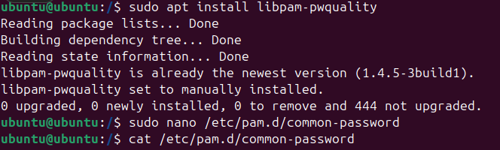

Solutions for preventing exploitation: Enforcing password policies
Install libpam-pwquality (Fig 6.) – Pluggable Authentication Module (PAM) that performs password quality checking (Canonical, 2019).
Modify password policies in /etc/pam.d/common-password (Fig 7.) – apply password policies into this new folder installed alongside the PAM module
Figure 6: Installation of linpam-pqwuality using “sudo apt install” command
Figure 6: Modification of /etc/pam.d/common-password using “sudo nano” command. “cat” command used to show new password policies implemented.
Notes:
Canonical (2019). Ubuntu Manpage: pam_pwquality - PAM module to perform password quality checking. [online] Ubuntu.com. Available at: https://manpages.ubuntu.com/manpages/jammy/man8/pam_pwquality.8.html.

Slide 9
Solutions for preventing exploitation: Enforcing password policies in /etc/pam.d/common-password
retry=3 – number of login attempts allowed set to 3.
  Helps protect account from password guesses due to limited attempts
minlen=10 – minimum length of password
lcredit=-1 – minimum number of uppercases
dcredit=-1 – minimum number of digits
ocredit=-1 minimum number of other characters.
  All being set to -1 means there must be at least one character.
  Allows passwords to have a variety of characters, which limits the presence of common patterns/dictionary words & increases time complexity.

Slide 10
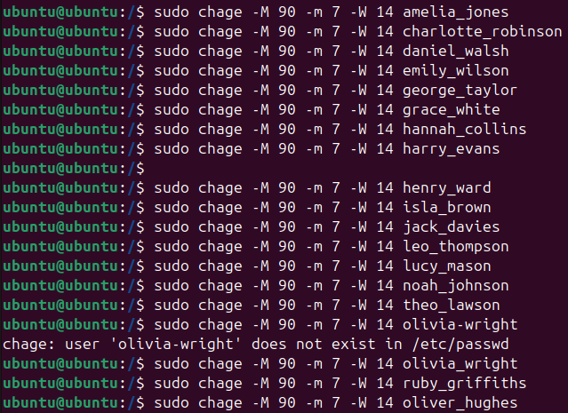
Solutions for preventing exploitation: Enforcing password expiry and organisation procedures
sudo chage –M 90 –n 7 –W 14 username(Fig 6.) – make users change their passwords every 90 days, prevents common password reuse.
  Common reuse provides more opportunity for unauthorised access, as the same password is being used everywhere.
Users must be alerted to these password policies and comply with them as it’s a new security practice required within the organisation.
Figure 7: Enforcing passwords to be changed every 90 days
NCSC recommendations (NCSC, 2018):
  Use 3 random unrelated words together to make a password.
  Use password software managers to generate & store unique passwords
Notes:
NCSC (2018). Password administration for system owners. [online] Ncsc.gov.uk. Available at: https://www.ncsc.gov.uk/collection/passwords/updating-your-approach.

Slide 11
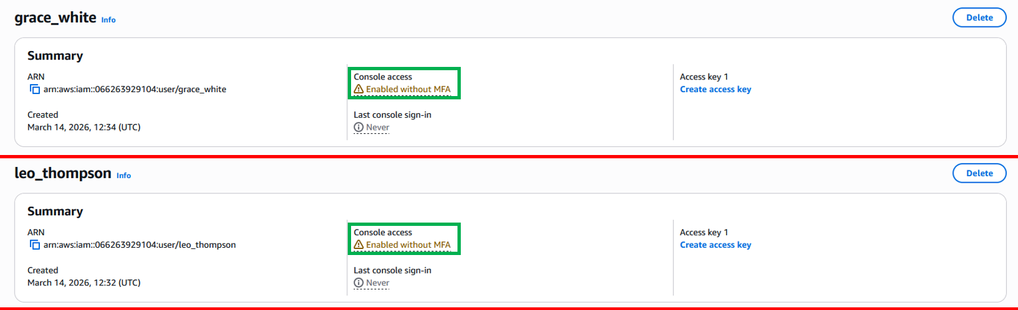
Initial AWS Vulnerable Setup
No employee has Multi-Factor Authentication set up within the organisation.
Multi-Factor Authentication: a multi-step account login process that requires users to verify themselves more than once (Amazon Web Services, 2023). After entering a password, you will need to verify that you are the correct user a second time.
Having just a password as your setup within AWS, a cloud service, is very risky. Unlike Ubuntu, where password policies can be enforced locally, password-only authentication is more vulnerable because attackers have multiple ways to obtain passwords which can result in unauthorised access and harm.
This is because the cloud and its data is accessible to anyone over the internet, which makes strong authentication a mandatory requirement (Sen, n.d.).
Figure 8: Both employees, Grace White and Leo Thompson don’t have MFA activated on their accounts.
Notes:
Amazon Web Services (2023). What Is Multi-Factor Authentication (MFA)? - Cloud Security Beginner’s Guide - AWS. [online] Amazon Web Services, Inc. Available at: https://aws.amazon.com/what-is/mfa/.
Sen, J. (n.d.). Security and Security and Security and Security and Privacy Privacy Privacy Privacy Issues Issues Issues Issues in C in C in C in Cloud loud loud loud Computing Computing Computing Computing. [online] Available at: https://arxiv.org/pdf/1303.4814.

Slide 12
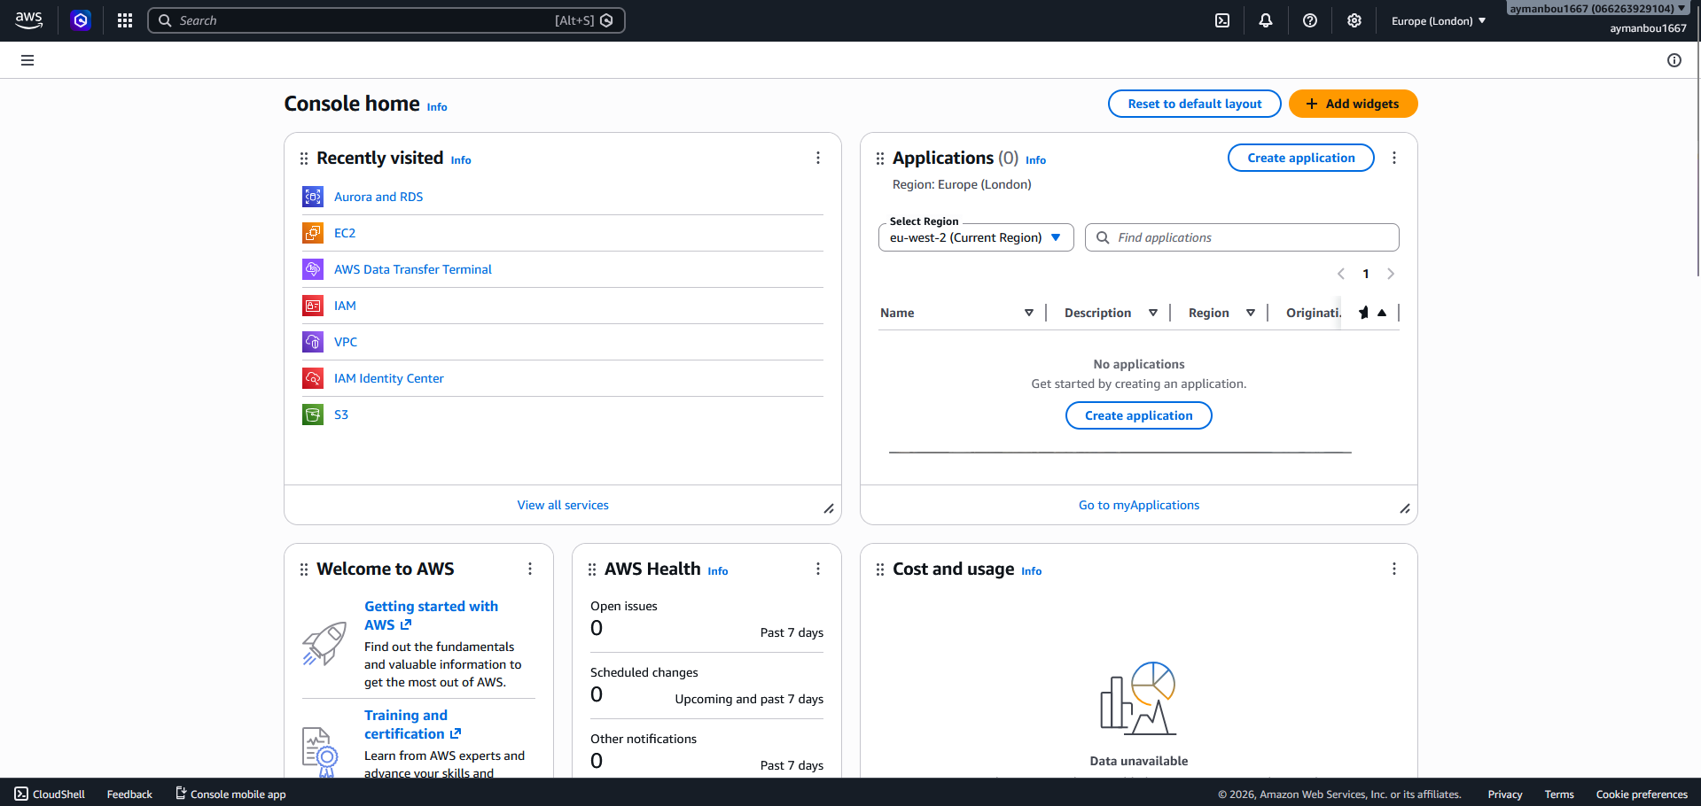
How can an AWS password be obtained
Passwords can be obtained using multiple methods. A few methods are:
  Password spraying – attempting commonly used passwords
  Traffic Interception – password can be intercepted if stored in clear text and device is accessed
  Rainbow Attacks: comparing a password’s hash to hashes stored in a rainbow table
  Brute-force attacks: using all possible combinations of characters in a password until the right one
Figure 9: Home page of AWS after a successful login

Slide 13
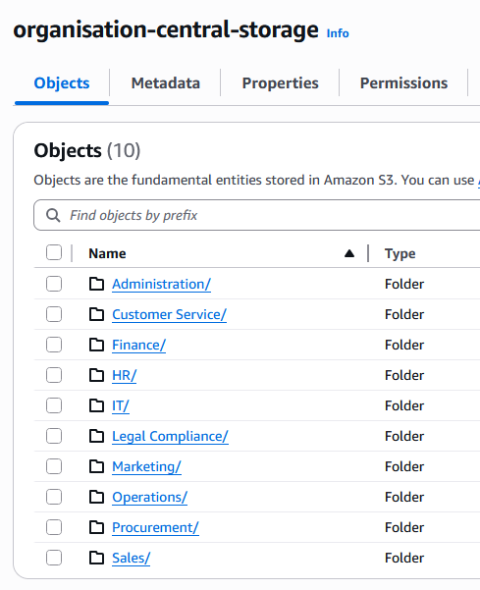
Consequences of an AWS breach
An Amazon Simple Storage Service (S3) Bucket is a storage service where users can store any amount of data (AWS, 2023).
Figure 9 shows the organisation’s data, where they have 10 folders that are named after their departments. The unauthorised user has all the time to perform whatever harm they intend.
There are grave consequences for a Security Breach:
  Reputational Damage: organisation’s reputation gets damaged, and affected customers may seek compensation or leave the service
  Vandalism: a hacker may modify or delete the data they found, or obtain it for themselves
  Theft: attackers may publish the data or use it for financial theft
  Damaged intellectual property: competitiveness cripples if hackers steal confidential information & exposure of property can remove long-term advantage.
Figure 9: S3 Bucket that contains folder names by department
Notes:
AWS (2023). What is Amazon S3? - Amazon Simple Storage Service. [online] docs.aws.amazon.com. Available at: https://docs.aws.amazon.com/AmazonS3/latest/userguide/Welcome.html.

Slide 14
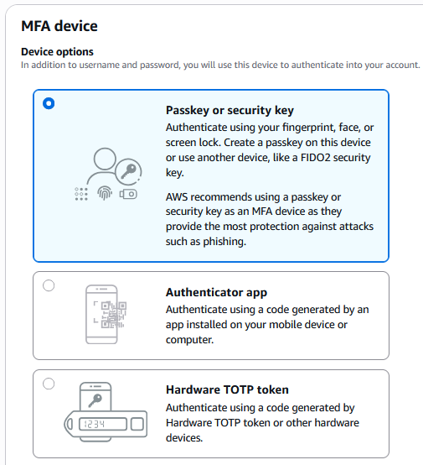
Solutions for Implementing MFA in AWS
Passkey or security key – implement a fingerprint or face as your key, as they’re your natural features. They will be scanned and compared the next time you try to sign in using the method. If the features match, you log in successfully.
Authenticator app – connect the account with an authenticator app on your phone. After each login attempt, you use the app to verify that you’re the right user by entering a different code given each time. If you enter the right code you log in.
Hardware TOTP token – uses a physical device to generate one-time passcodes. If the hacker logs in with your password, they cannot access your account as they need the code from the hardware.
Figure 10: MFA methods in AWS

Slide 15
Solutions for Implementing MFA in AWS
Implement MFA as a policy within the business – Users must be alerted about implementing MFA and comply with it. It is possible to view who has implemented it using the Identity Access Management(IAM) Users page.
Still implement a strong password regardless of MFA being used – The NCSC recommendations of using 3 random unrelated words together to make a password, which increases time complexity, still stand in AWS.
  If you want to refer back to the password, use password software managers to generate & store unique passwords

Slide 16
Summary
Authentication verifies a user’s identity to access a system, protecting against unauthorised access.
The system can become vulnerable if password policies aren’t in place, as it allows weak passwords to be implemented.
Using Linux, easy passwords can be discovered in a short time frame using a user’s data and their password hash.
The cloud is accessible to anyone who is on the internet, which makes MFA a mandatory security procedure.
Users must be alerted and comply with new password policies.
Password policies include password requirements, password expiry dates and MFA.

Slide 17
References
National Cyber Security Centre (2022). Selecting right methods to authenticate customers. [online] Available at: https://www.ncsc.gov.uk/guidance/authentication-methods-choosing-the-right-type
National Cyber Security Centre (2019) Most hacked passwords revealed as UK cyber survey exposes gaps in online security, Ncsc.gov.uk. Available at: https://www.ncsc.gov.uk/news/most-hacked-passwords-revealed-as-uk-cyber-survey-exposes-gaps-in-online-security
The_Anshuman (2023). Understanding /etc/passwd and /etc/shadow Files - The_Anshuman - Medium. [online] Medium. Available at: https://medium.com/@The_Anshuman/understanding-etc-passwd-and-etc-shadow-files-58630eb0eda8.
Canonical (2019). Ubuntu Manpage: pam_pwquality - PAM module to perform password quality checking. [online] Ubuntu.com. Available at: https://manpages.ubuntu.com/manpages/jammy/man8/pam_pwquality.8.html.
NCSC (2018). Password administration for system owners. [online] Ncsc.gov.uk. Available at: https://www.ncsc.gov.uk/collection/passwords/updating-your-approach.

Slide 18
References
Amazon Web Services (2023). What Is Multi-Factor Authentication (MFA)? - Cloud Security Beginner’s Guide - AWS. [online] Amazon Web Services, Inc. Available at: https://aws.amazon.com/what-is/mfa/.
Sen, J. (n.d.). Security and Security and Security and Security and Privacy Privacy Privacy Privacy Issues Issues Issues Issues in C in C in C in Cloud loud loud loud Computing Computing Computing Computing. [online] Available at: https://arxiv.org/pdf/1303.4814.
AWS (2023). What is Amazon S3? - Amazon Simple Storage Service. [online] docs.aws.amazon.com. Available at: https://docs.aws.amazon.com/AmazonS3/latest/userguide/Welcome.html.

